Slide 1
UNIT II
ATTACKS AND COUNTERMEASURES
OWASP; Malicious Attack Threats and Vulnerabilities: Scope of Cyber-Attacks – Security Breach – Types of Malicious Attacks – Malicious Software – Common Attack Vectors – Social engineering Attack – Wireless Network Attack – Web Application Attack – Attack Tools – Countermeasures.
COURSE CODE: 21AIM643
COURSE NAME: CYBER SECURITY
FACULTY NAME: K.S.SHASHIKALA

Slide 2
OWASP
The Open Web Application Security Project, or OWASP, is an international non-profit organization dedicated to web application security.
One of OWASP’s core principles is that all of their materials be freely available and easily accessible on their website, making it possible for anyone to improve their own web application security.
The materials they offer include documentation, tools, videos, and forums.
Their best-known project is the OWASP Top 10.
What is the OWASP Top 10?
The OWASP Top 10 is a regularly-updated report outlining security concerns for web application security, focusing on the 10 most critical risks.
The report is put together by a team of security experts from all over the world.
OWASP refers to the Top 10 as an ‘awareness document’ and they recommend that all companies incorporate the report into their processes in order to minimize and/or mitigate security risks.

Slide 3
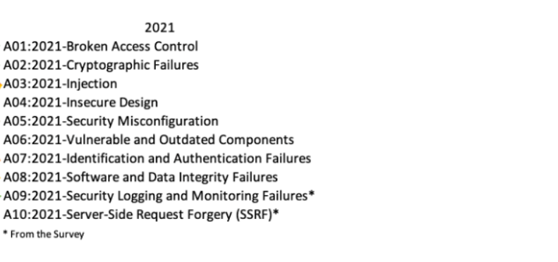
TOP10 threats in OWASP-2021
OWASP Top Ten is the list of the 10 most common application vulnerabilities.
It also shows their risks, impacts, and countermeasures. Updated every three to four years, the latest OWASP vulnerabilities list was released September 24, 2021

Slide 4
1 Broken Access Control
Broken Access Control moved up from the fifth most severe risk in 2017 to the top risk in 2021. There were more instances of Common Weakness Enumerators (CWE) for this than any other category.
Here are some examples of what we consider to be “access”:
Access to a hosting control / administrative panel
Access to a server via FTP / SFTP / SSH
Access to a website’s administrative panel
Access to other applications on your server
Access to a database
Attackers can exploit authorization flaws to accomplish the following:
Access unauthorized functionality and/or data
View sensitive files
Change access rights
Edit files and records

Slide 5
2. Cryptographic Failures
Previously known as “Sensitive Data Exposure”, it was renamed to better reflect the root cause of the issue. It moves up from number three to runner-up in widespread vulnerabilities on the OWASP list. It consists of a failure to protect sensitive data that should not have been publicly accessible.
Examples of Cryptographic Failures
Sensitive data that requires protection includes:
Credentials
Credit card numbers
Social Security numbers
Medical information
Personally identifiable information (PII)
Other personal information

Slide 6
3. Injection
A code injection happens when an attacker sends invalid data to the web application with the intention of making it do something that the application is not designed/programmed to do.
Perhaps the most common example around this security vulnerability is the SQL query consuming untrusted data. You can see one of OWASP’s examples below:
String query = “SELECT * FROM accounts WHERE custID = ‘” + request.getParameter(“id”) + “‘”;
This query can be exploited by calling up the web page and executing it with the following URL: https://example.com/app/accountView?id=’ or ‘1’=’1 causing the return of all the rows stored on the database table.
4. Insecure Design
A new addition to the OWASP Top Ten, clocking in at number four on the list, is insecure design. This focuses on the ground-up development of web applications from the very beginning of its life cycle. This is not to be confused with insecure implementation of web applications or policies.
One can have a secure design and insecure implementation but not the other way around. It is, essentially, the avoidance of hard-coded security protocols and methods within the initial development of a web application, as well as the failure to take into account risks and attack vectors during the planning, development, and implementation of a web application.

Slide 7
5. Security Misconfigurations
This category moves up one notch from the previous top 10 list published in 2017. The previous category for XML External Entities (XXE) has been rolled into this one. There is a litany of possible security misconfigurations, but here are the most common:
Unpatched flaws
Default configurations
Unused pages
Unprotected files and directories
Unnecessary services
Usage of vulnerable XML files
6. Vulnerable and Outdated Components
Even simple websites such as personal blogs have a lot of dependencies, plugins, extensions and third party code. Failing to update every piece of software on the backend and frontend of a website will introduce heavy security risks sooner rather than later. Attackers actively seek out websites using vulnerable components and aggressively exploit them to spread malware, spam and phishing.
For example, in 2019, 56% of all CMS applications were out of date at the point of infection.

Slide 8
7.Identification and Authentication Failures
A broken authentication vulnerability can allow an attacker to use manual and/or automatic methods to try to gain control over any account they want in a system – or even worse – to gain complete control over the system.
Websites with broken authentication vulnerabilities are very common on the web. Broken authentication usually refers to logic issues that occur on the application authentication’s mechanism, like bad session management prone to username enumeration – when a malicious actor uses brute-force techniques to either guess or confirm valid users in a system.
8.Software and Data Integrity Failures
Another new addition to the 2021 roster is software and data integrity failures. These failures can take many forms, particularly since as the web evolves it is more and more common to use third party code and services within web applications. These failures can be summarised as follows:
Usage of code that does not verify integrity of source
Usage of third party plugins where you do not control the source
Plugins and extensions from untrusted sources
The introduction of or potential for compromise or unauthorised access
Auto-updates assume trust of the source

Slide 9
9. Security Logging & Monitoring Failures
According to OWASP, these are some examples of attack scenarios due to insufficient logging and monitoring:
Scenario #1: An open-source project forum software run by a small team was hacked using a flaw in its software. The attackers managed to wipe out the internal source code repository containing the next version and all of the forum contents. Although the source could be recovered, the lack of monitoring, logging, or alerting led to a far worse breach. The forum software project is no longer active as a result of this issue.
Scenario #2: An attacker scans for users with a common password. They can take over all accounts with this password. For all other users, this scan leaves only one false login behind. After some days, this may be repeated with a different password.
Scenario #3: A major U.S. retailer reportedly had an internal malware analysis sandbox analyzing attachments. The sandbox software had detected potentially unwanted software, but no one responded to this detection. The sandbox had been producing warnings for some time before detecting the breach due to fraudulent card transactions by an external bank.

Slide 10
10.Server-Side Request Forgery
SSRF flaws occur whenever a web application is fetching a remote resource without validating the user-supplied URL. It allows an attacker to coerce the application to send a crafted request to an unexpected destination, even when protected by a firewall, VPN, or another type of network access control list (ACL).
As cloud services increase in usage and popularity as well as their complexity, the prevalence and risk of SSRF attacks increase too. As cloud services increase in usage and popularity as well as their complexity, the prevalence and risk of SSRF attacks increase too.
How to Prevent SSRF in Web Applications:
Sanitize all user input
Use a positive allow list rather than a punitive block list
Do not send raw responses to users/clients
Disable unencrypted (HTTP) redirections

Slide 11
Attack, Threats and vulnerabilities
The three common terms used in network security are as follows:
A threat is any potential occurrence, malicious or otherwise, that could harm an asset. In other words, a threat is any bad thing that can happen to your assets.
A vulnerability is a weakness that makes a threat possible. This may be because of poor design, configuration mistakes, or inappropriate and insecure coding techniques.
The vulnerabilities could be weaknesses in the technology, configuration, or security policy. Any discovered vulnerability must be addressed to mitigate any threat that could take advantage of the vulnerability.
An attack is an action that exploits a vulnerability or enacts a threat. Examples of attacks include sending malicious input to an application or flooding a network in an attempt to deny service.

Slide 12
Difference between threat and attack
The main difference between threat and attack is a threat can be either intentional or unintentional where as an attack is intentional.
Threat is a circumstance that has potential to cause loss or damage whereas attack is attempted to cause damage.
Threat to the information system doesn’t mean information was altered or damaged but attack on the information system means there might be chance to alter, damage, or obtain information when attack was successful.

Slide 13
Vulnerability
Vulnerability-A weakness that is inherent in every network and device. This includes:
routers, switches, desktops, servers, and even security devices themselves.
Networks are typically plagued by one or all of three primary vulnerabilities or weaknesses:
Configuration weaknesses
Technology weaknesses
Security policy weaknesses
Notes:
CTS
Switches facilitate the sharing of resources by connecting together all the devices, including computers, printers, and servers, in a small business network.

Slide 14
Vulnerability -Configuration Weaknesses
Network administrators or network engineers need to learn what the configuration weaknesses are and correctly configure their computing and network devices to compensate.
Insecure user accounts
A common problem is to turn on JavaScript in web browsers, enabling attacks by way of hostile JavaScript
System accounts with easily guessed passwords
Misconfigured Internet services
_{For example:} when accessing untrusted
sites
Misconfigured access lists, routing protocols Misconfigured or lack of encryption and
Insecure default settings within products
Misconfigured network equipment
For example:
remote-access controls

Slide 15
Vulnerability
Technology weaknesses
Computer and network technologies have intrinsic security weaknesses.(like Network equipment weakness, OS weakness, TCP/IP protocol weakness)
These include TCP/IP protocol weaknesses,
HTTP, FTP, and ICMP are inherently insecure
The UNIX, Linux, Macintosh, Windows NT, 9x, 2K, XP
operating system weaknesses,
Network equipment weaknesses.
Password protection Lack of authentication Routing protocols Firewall holes
such as routers, firewalls,
and switches, have security weaknesses

Slide 16
Threats
There are four primary classes of threats to network security:
Unstructured threats consist of mostly inexperienced individuals using easily available hacking tools such as shell scripts and password crackers.
Even unstructured threats that are only executed with the intent of
testing and challenging a hacker’s skills can still do serious damage to a company.
Unstructured threats—Threats that are random and usually the result of an attacker identifying the vulnerability by scanning the network looking for “targets of opportunity.”
This type of threat is by far the most common threat because it can be performed using automated tools (scripts) that are readily available on the Internet and can be performed by someone with very limited computer skills.

Slide 17
Threats
Structured threats : threats that are preplanned and focus on a specific target.
A structured threat is an organized effort to breach a specific network or organization
These threats come from hackers who are more highly motivated and technically competent.
These people know system vulnerabilities and can understand and develop exploit code and scripts.

Slide 18
Threats
External threats can arise from individuals or organizations working outside of a company.
They do not have authorized access to the computer systems or network.
They work their way into a network mainly from the Internet or dialup access servers

Slide 19
Threats
Internal threats occur when someone has authorized access to the network with either an account on a server or physical access to the network.
According to the FBI, internal accessors misuse account for 60 percent to 80 percent of reported incidents.

Slide 20
Attack
The threats use a variety of tools, scripts, and programs to launch attacks against networks and network devices.
Typically, the network devices under attack are the endpoints, such as servers and desktops
The home page of numerous organizations has been attacked and replaced by a new home page of the choosing crackers.
Sites that have been cracked include Yahoo, the U.S. Army, the CIA, NASA, and the New York Times.
In most cases, the crackers just put up some funny text and the sites were repaired within a few hours.

Slide 21
Attacks
Numerous sites have been brought down by denial- of-service attacks, in which the cracker floods the site with traffic, rendering it unable to respond to legitimate queries.
Often the attack is mounted from a large number of machines that the cracker has already broken into (DoS atacks).
These attacks are so common.
They can cost the attacked site thousands of dollars in lost business

Slide 22
Attacks
Four primary classes of attacks exist:
Reconnaissance
Access
Denial of service
Worms, viruses, and Trojan horses

Slide 23
SECURITY BREACH
Physical security is arguably the most critical area of IT security for preventing the loss or theft of confidential and sensitive data
Some of the common security breaches caused by insufficient physical security are as follows:
Installation of malware such as keyloggers, viruses, Trojans, backdoors, or rootkits
Identification and capture of validation or authentication credentials such as passwords or certificates
Physical connection to the wired network to sniff confidential data such as passwords and credit card numbers Access to systems to collect data that can be used to crack passwords stored locally on the system
Hacker gaining physical access to the server, a single client system, or a network port
Opportunity to plant rogue access points to create an open wireless network with access to the wired network
Theft of paper or electronic documents
Theft of sensitive fax information
Dumpster diving attack (emphasizing the need to shred important documents)

Slide 24
Security measures
Security measures can be categorized in the following three ways:
1.Physical
Physical measures to prevent access to systems include security guards, lighting, fences, locks, and alarms. Facility access points should be limited, and they should be monitored/protected by closed-circuit television (CCTV) cameras and alarms. The entrance to the facility should be restricted to authorized people. Access to laptop systems and removable media such as removable drives, backup tapes, and disks should be restricted and protected. Computer screens should be positioned such that they can’t be seen by passers-by, and a policy should be implemented and enforced that requires users to lock their systems when they leave the computer for any reason. Computer systems with highly sensitive data should be protected in an enclosed and locked area such as a credential-access room with a rack-mount case and lock.
2.Technical
Technical security measures such as firewalls, IDS, spyware content filtering, and virus and Trojan scanning should be implemented on all remote client systems, networks, and servers.
3.Operational
Operational security measures to analyze threats and perform risk assessments should be a documented process in the organization’s security policy.

Slide 25
Malicious software
Malware is also called as malicious software. It is commonly used by hackers to attack compromised systems.
It is designed to cause harm or damage to a computer, server, client or computer network and/or infrastructure without end-user knowledge.
Cyber attackers create, use and sell malware for many different reasons, but it is most frequently used to steal personal, financial or business information.
Some potentially harmful malware are trojans, backdoors, viruses and worms

Slide 26
Types of Malicious Attacks
Backdoor
Most malware types can be classified into one of the following categories: trojans, backdoors, viruses and worms
A backdoor is a program or a set of related programs that a hacker installs on a target system to allow access to the system at a later time.
A backdoor’s goal is to remove the evidence of initial entry from the system’s log files.
But a backdoor may also let a hacker retain access to a machine it has penetrated even if the intrusion has already been detected and remedied by the system administrator.
Adding a new service is the most common technique to disguise backdoors in the Windows operating system. The hacker could add a new service and give it an unnoticeable name or better yet choose a service that’s never used and that is either activated manually or completely disabled.

Slide 27
Backdoor - Example
Remote Administration Trojans (RATs) are a class of backdoors used to enable remote control over a compromised machine. They provide apparently useful functions to the user and, at the same time, open a network port on the victim computer.
Once the RAT is started, it behaves as an executable file, interacting with certain registry keys responsible for starting processes and sometimes creating its own system services.
Unlike common backdoors, RATs hook themselves into the victim operating system and always come packaged with two files: the client file and the server file.
The server is installed in the infected machine, and the client is used by the intruder to control the compromised system
Notes:
https://drive.google.com/drive/u/0/folders/1oj2VyKUgEMF0F1sF92tOFmrY7T-GVglb 2024-achievements folder

Slide 28
Trojan
A Trojan is a malicious program disguised as something benign. Trojans are often downloaded along with another program or software package.
Once installed on a system, they can cause data theft and loss, and system crashes or slowdowns; they can also be used as launching points for other attacks such as Distributed Denial of Service (DDOS).
Many Trojans are used to manipulate files on the victim computer, manage processes, remotely run commands, intercept keystrokes, watch screen images, and restart or shut down infected hosts. Sophisticated Trojans can connect themselves to their originator or announce the Trojan infection on an Internet Relay Chat (IRC) channel.
Trojans ride on the backs of other programs and are usually installed on a system without the user's knowledge.
A Trojan can be sent to a victim system in many ways: as an Instant Messenger (IM) attachment, IRC, an e-mail attachment, or NetBIOS file sharing. Many fake programs purporting to be legitimate software such as freeware, spyware-removal tools, system optimizers, screen savers, music, pictures, games, and videos can install a Trojan on a system just by being downloaded

Slide 29
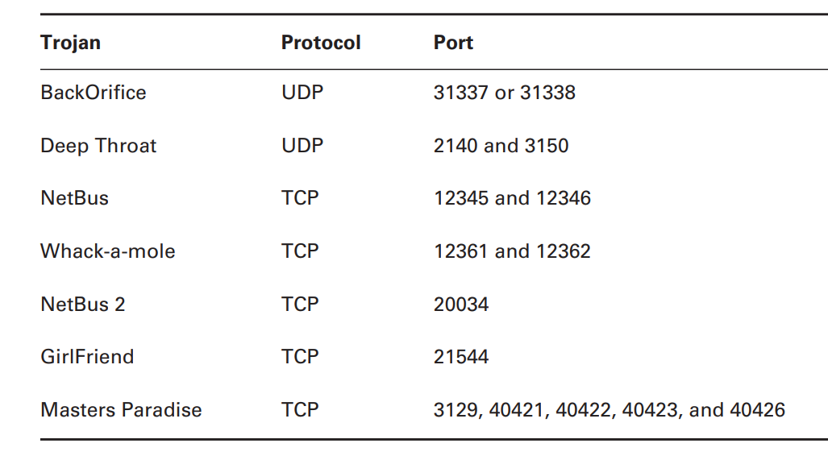
COMMON TROJAN PROGRAMS

Slide 30
Viruses and Worms
Viruses and worms can be used to infect a system and modify a system to allow a hacker to gain access.
Many viruses and worms carry Trojans and backdoors. In this way a virus or worm is a carrier and allows malicious code such as Trojans and backdoors to be transferred from system to system much in the way that contact between people allows germs to spread.
A virus infects another executable and uses this carrier program to spread itself. The virus code is injected into the previously benign program and is spread when the program is run. Examples of virus carrier programs are macros, e-mail attachments, Visual Basic scripts, games, and animations
A worm is a type of virus, but it is self-replicating. A worm spreads from system to system automatically, but a virus needs another program in order to spread. Viruses and worms both execute without the knowledge or desire of the end user.
Notes:
Benign-something harmless and not a threat

Slide 31
Types of Viruses
Viruses are classified according to two factors: what they infect and how they infect
A virus can infect the following components of a system:
System sectors
Files
Macros (such as Microsoft Word macros)
Companion files (supporting system files like DLL and INI files)
Disk clusters
Batch files (BAT files)
Source code

Slide 32
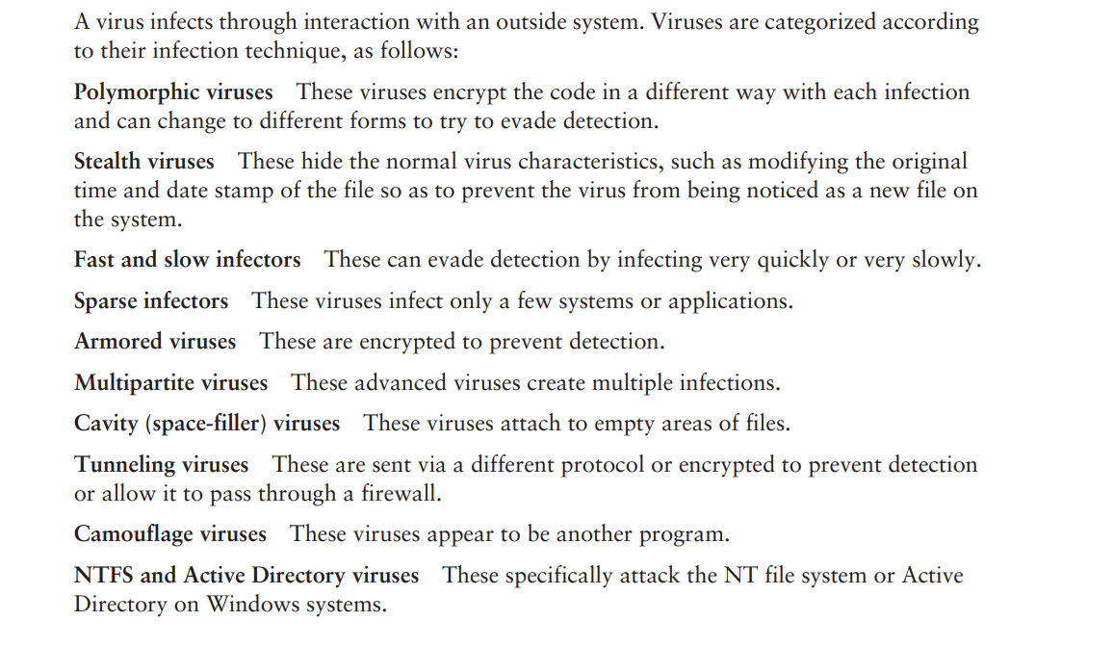
How a Virus Spreads and Infects the System

Slide 33
Virus Detection Methods
The following techniques are used to detect viruses:
Scanning
Integrity checking with checksums
Interception based on a virus signature
The process of virus detection and removal is as follows:
Detect the attack as a virus. Not all anomalous behavior can be attributed to a virus.
2. Trace processes using utilities such as handle.exe, listdlls.exe, fport.exe, netstat.exe, and pslist.exe, and map commonalities between affected systems.
3. Detect the virus payload by looking for altered, replaced, or deleted files. New files, changed file attributes, or shared library files should be checked.
4. Acquire the infection vector and isolate it. Then, update your antivirus definitions and rescan all systems.

Slide 34
EICAR TEST FILE
The EICAR Anti-Virus Test File or EICAR test file is a computer file that was developed by the European Institute for Computer Antivirus Research (EICAR) and Computer Antivirus Research Organization (CARO), to test the response of computer antivirus programs.
A test virus can be created by typing the following code in Notepad and saving the file as EICAR.COM.
Your antivirus program should respond when you attempt to open, run, or copy it. X5O!P%@AP[4\PZX54(P^)7CC)7}$EICAR-STANDARD-ANTIVIRUS-TEST-FILE!$H+H*
Instead of using real malware, which could cause real damage, this test file allows people to test anti-virus software without having to use a real computer virus.

Slide 35
Hybrid malware:
Modern malware is often a “hybrid” or combination of malicious software types. For example, “bots” first appear as Trojans then, once executed, act as worms. They are frequently used to target individual users as part of a larger network-wide cyber attack.
Logic Bombs
A logic bomb is a malicious program that uses a trigger to activate the malicious code. The logic bomb remains non-functioning until that trigger event happens. Once triggered, a logic bomb implements a malicious code that causes harm to a computer.
Cybersecurity specialists recently discovered logic bombs that attack and destroy the hardware components in a workstation or server including the cooling fans, hard drives, and power supplies. The logic bomb overdrives these devices until they overheat or fail.

Slide 36
Adware: Adware serves unwanted and aggressive advertising (e.g., pop-up ads) to the end-user.
Malvertising: Malvertising uses legitimate ads to deliver malware to end-user machines.
Spyware: Spyware spies on the unsuspecting end-user, collecting credentials and passwords, browsing history and more.
Ransomware:
Ransomware infects machines, encrypts files and holds the needed decryption key for ransom until the victim pays. Ransomware attacks targeting enterprises and government entities are on the rise, costing organizations millions as some pay off the attackers to restore vital systems. Cyptolocker, Petya and Loky are some of the most common and notorious families of ransomware.

Slide 37
Rootkits
A rootkit modifies the OS to make a backdoor. Attackers then use the backdoor to access the computer distantly. Most rootkits take advantage of software vulnerabilities to modify system files.
Keyloggers
Keylogger records everything the user types on his/her computer system to obtain passwords and other sensitive information and send them to the source of the keylogging program.

Slide 38
Common Attack Vectors
In cybersecurity, an attack vector is a method of achieving unauthorized network access to launch a cyber attack.
Attack vectors allow cybercriminals to exploit system vulnerabilities to gain access to sensitive data, personally identifiable information (PII), and other valuable information accessible after a data breach.
An attack vector is a method of gaining unauthorized access to a network or computer system.
An attack surface is the total number of attack vectors an attacker can use to manipulate a network or computer system or extract data.
Threat vector can be used interchangeably with attack vector and generally describes the potential ways a hacker can gain access to data or other confidential information.

Slide 39
Examples
1. Compromised Credentials
‍Usernames and passwords are still the most common type of access credential and continue to be exposed in data leaks, phishing scams, and malware. When lost, stolen, or exposed, credentials give attackers unfettered access. This is why organizations are now investing in tools to continuously monitor for data exposures and leaked credentials. Password managers, two-factor authentication (2FA), multi-factor authentication (MFA), and biometrics can reduce the risk of leak credentials resulting in a security incident too.
2. Weak Credentials
‍Weak passwords and reused passwords mean one data breach can result in many more. Teach your organization how to create a secure password, invest in a password manager or a single sign-on tool, and educate staff on their benefits.
3. Insider Threats
‍Disgruntled employees or malicious insiders can expose private information or provide information about company-specific vulnerabilities.
4. Missing or Poor Encryption
‍Common data encryption methods like SSL certificates and DNSSEC can prevent man-in-the-middle attacks and protect the confidentiality of data being transmitted. Missing or poor encryption for data at rest can mean that sensitive data or credentials are exposed in the event of a data breach or data leak

Slide 40
.
5.Misconfiguration
‍Misconfiguration of cloud services, like Google Cloud Platform, Microsoft Azure, or AWS, or using default credentials can lead to data breaches and data leaks, check your S3 permissions or someone else will. Automate configuration management where possible to prevent configuration drift.
6. Ransomware
‍Ransomware is a form of extortion where data is encrypted unless a ransom is paid, such as WannaCry. Minimize the impact of ransomware attacks by maintaining a defense plan, including keeping your systems patched and backing up important data.
7. Phishing
‍Phishing attacks are social engineering attacks where the target is contacted by email, telephone, or text message by someone who is posing to be a legitimate colleague or institution to trick them into providing sensitive data, credentials, or personally identifiable information (PII). Fake messages can send users to malicious websites with viruses or malware payloads.
Notes:
Patching operating systems is one of the most effective controls an organisation can implement to prevent an adversary from gaining access to their devices and sensitive information. improve the security of operating systems by fixing known vulnerabilities.

Slide 41
8. Vulnerabilities
‍New security vulnerabilities are added to the CVE every day and zero-day vulnerabilities are found just as often. If a developer has not released a patch for a zero-day vulnerability before an attack can exploit it, it can be hard to prevent zero-day attacks.
9. Brute Force
‍Brute force attacks are based on trial and error. Attackers may continuously try to gain access to your organization until one attack works. This could be by attacking weak passwords or encryption, phishing emails, or sending infected email attachments containing a type of malware.
10. Distributed Denial of Service (DDoS)
DDoS attacks are cyber attacks against networked resources like data centers, servers, websites, or web applications and can limit the availability of a computer system. The attacker floods the network resource with messages which cause it to slow down or even crash, making it inaccessible to users. Potential mitigations include CDNs and proxies.
11. SQL Injections
‍SQL stands for a structured query language, a programming language used to communicate with databases. Many of the servers that store sensitive data use SQL to manage the data in their database. An SQL injection uses malicious SQL to get the server to expose information it otherwise wouldn't. This is a huge cyber risk if the database stores customer information, credit card numbers, credentials, or other personally identifiable information (PII).
12. Trojans
‍Trojan horses are malware that misleads users by pretending to be a legitimate program and are often spread via infected email attachments or fake malicious software.
Notes:
CDN is a network of servers linked together with the goal of delivering content as quickly, cheaply, reliably, and securely as possible.

Slide 42
13. Cross-Site Scripting (XSS)
XSS attacks involve injecting malicious code into a website but the website itself is not being attacked, rather it aims to impact the website's visitors. A common way attackers can deploy cross-site scripting attacks is by injecting malicious code into a comment e.g. embedding a link to malicious JavaScript in a blog post's comment section.
14. Session Hijacking
‍When you log into a service, it generally provides your computer with a session key or cookie so you don't need to log in again. This cookie can be hijacked by an attacker who uses it to gain access to sensitive information.
15. Man-in-the-Middle Attacks
‍Public Wi-Fi networks can be exploited to perform man-in-the-middle attacks and intercept traffic that was supposed to go elsewhere, such as when you log into a secure system.
16. Third and Fourth-Party Vendors
‍The rise in outsourcing means that your vendors pose a huge cybersecurity risk to your customer's data and your proprietary data. Some of the biggest data breaches were caused by third parties.

Slide 43
How Do Hackers Exploit Attack Vectors?
Hackers use multiple threat vectors to exploit vulnerable systems, attack devices and networks, and steal data from individuals. There are two main types of hacker vector attacks: passive attacks and active attacks.
Passive Attack
A passive attack occurs when an attacker monitors a system for open ports or vulnerabilities to gain or gather information about their target. Passive attacks can be difficult to detect because they do not involve altering data or system resources. Rather than cause damage to an organization’s systems, the attacker threatens the confidentiality of their data.
Passive attack vectors include passive reconnaissance, which sees the attacker monitor an organization’s systems for vulnerabilities without interacting with them through tools like session capture, and active reconnaissance, where the attacker uses methods like port scans to engage with target systems.
Active Attack
An active attack vector is one that sets out to disrupt or cause damage to an organization’s system resources or affect their regular operations. This includes attackers launching attacks against system vulnerabilities, such as denial-of-service (DoS) attacks, targeting users’ weak passwords, or through malware and phishing attacks.
A common example of an active attack is a masquerade attack, in which an intruder pretends to be a trusted user and steals login credentials to gain access privileges to system resources. Active attack methods are often used by cyber criminals to gain the information they need to launch a wider cyberattack against an organization.

Slide 44
SOCIAL ENGINEERING ATTACK
Source:
Kimberly Graves, “CEH Official Certified Ethical hacker Review Guide”, Wiley Publishers, 2007,Chapter 2,Page no.57
Social engineering is a nontechnical method of breaking into a system or network. It’s the process of deceiving users of a system and convincing them to give out information that can be used to defeat or bypass security mechanisms.
Social engineering is the use of influence and persuasion to deceive people for the purpose of obtaining information or persuading a victim to perform some action.
A social engineer commonly uses the telephone or Internet to trick people into revealing sensitive information or to get them to do something that is against the security policies of the organization.
By this method, social engineers exploit the natural tendency of a person to trust their word, rather than exploiting computer security holes.

Slide 45
Example of social engineering:
Recounted by Kapil Raina, currently a security expert at Verisign, based on an actual workplace experience with a previous employer.
“One morning a few years back, a group of strangers walked into a large shipping firm and walked out with access to the firm’s entire corporate network. How did they do it? By obtaining small amounts of access, bit by bit, from a number of different employees in that firm. First, they did research about the company for two days before even attempting to set foot on the premises. For example, they learned key employees’ names by calling HR. Next, they pretended to lose their key to the front door, and a man let them in. Then they “lost” their identity badges when entering the third floor secured area, smiled, and a friendly employee opened the door for them. The strangers knew the CFO was out of town, so they were able to enter his office and obtain financial data off his unlocked computer. They dug through the corporate trash, finding all kinds of useful documents. They asked a janitor for a garbage pail in which to place their contents and carried all of this data out of the building in their hands.
The strangers had studied the CFO’s voice, so they were able to phone, pretending to be the CFO, in a rush, desperately in need of his network password. From there, they used regular technical hacking tools to gain super-user access into the system. In this case, the strangers were network consultants performing a security audit for the CFO without any other employees’ knowledge. They were never given any privileged information from the CFO but were able to obtain all the access they wanted through social engineering.” The most dangerous part of social engineering is that companies with authentication processes, firewalls, virtual private networks, and network-monitoring software are still wide open to attacks, because social engineering doesn’t assault the security measures directly.

Slide 46
TYPES OF SOCIAL ENGINEERING ATTACKS
Social engineering can be broken into two common types:
1.Human-based
Human-based social engineering refers to person-to-person interaction to retrieve the desired information. An example is calling the help desk and trying to find out a password.
2.Computer-based
Computer-based social engineering refers to having computer software that attempts to retrieve the desired information. An example is sending a user an e-mail and asking them to reenter a password in a web page to confirm it. This social-engineering attack is also known as phishing.

Slide 47
Human-Based Social Engineering
Human-based social engineering techniques can be broadly categorized as follows:
Impersonating an employee or valid user
In this type of social-engineering attack, the hacker pretends to be an employee or valid user on the system. A hacker can gain physical access by pretending to be a janitor, employee, or contractor. Once inside the facility, the hacker gathers information from trashcans, desktops, or computer systems.
Posing as an important user
In this type of attack, the hacker pretends to be an important user such as an executive or high-level manager who needs immediate assistance to gain access to a computer system or files. The hacker uses intimidation so that a lower-level employee such as a help-desk worker will assist them in gaining access to the system. Most low-level employees won’t question someone who appears to be in a position of authority.
Using a third person
Using the third-person approach, a hacker pretends to have permission from an authorized source to use a system. This attack is especially effective if the supposed authorized source is on vacation or can’t be contacted for verification. Calling technical support
Calling tech support for assistance is a classic social-engineering technique. Help-desk and technical support personnel are trained to help users, which makes them good prey for social-engineering attacks.

Slide 48
Shoulder surfing
Shoulder surfing is a technique of gathering passwords by watching over a person’s shoulder while they log in to the system. A hacker can watch a valid user log in and then use that password to gain access to the system.
Dumpster diving
Dumpster diving involves looking in the trash for information written on pieces of paper or computer printouts. The hacker can often find passwords, filenames, or other pieces of confidential information.
A more advanced method of gaining illicit information is known as reverse social engineering. Using this technique, a hacker creates a persona that appears to be in a position of authority so that employees ask the hacker for information, rather than the other way around. For example, a hacker can impersonate a help-desk employee and get the user to give them information such as a password

Slide 49
Computer-Based Social Engineering
Computer-based social engineering attacks can include the following:
E-mail attachments
Fake websites
Popup windows
Identity Theft
A hacker can pose as an employee or steal the employee’s identity to perpetrate an attack. Information gathered in dumpster diving or shoulder surfing in combination with creating fake ID badges can gain the hacker entry into an organization. Creating a persona that can enter the building unchallenged is the goal of identity theft

Slide 50
Phishing Attacks
Phishing involves sending an e-mail, usually posing as a bank, credit-card company, or other financial organization. The e-mail requests that the recipient confirm banking information or reset passwords or PIN numbers. The user clicks the link in the e-mail and is redirected to a fake website. The hacker is then able to capture this information and use it for financial gain or to perpetrate other attacks. E-mails that claim the senders have a great amount of money but need your help getting it out of the country are examples of phishing attacks

Slide 51
Online Scams
Some websites that make free offers or other special deals can lure a victim to enter a username and password that may be the same as those they use to access their work system. The hacker can use this valid username and password once the user enters the information in the website form. Mail attachments can be used to send malicious code to a victim’s system, which could automatically execute something like a software keylogger to capture passwords. Viruses, Trojans and worms can be included in cleverly crafted e-mails to entice a victim to open the attachment. Mail attachments are considered a computer-based social engineering attack.

Slide 52
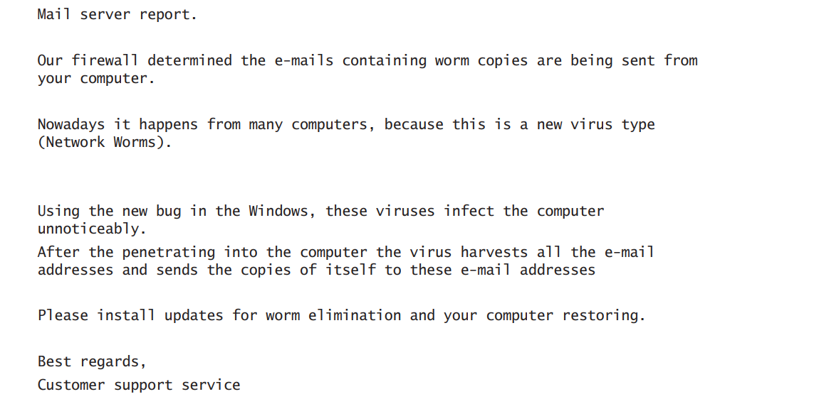
E-MAIL SCAM EXAMPLE

Slide 53
URL Obfuscation
URL is the Uniform Resource Locator and is commonly used in the address bar of a web browser to access a particular website. In lay terms it is the website address. URL obfuscation is the hiding or a fake URL in what appear to be a legitimate website address. For example, a website of 204.13.144.2/Citibank may appear to be a legitimate web address for Citibank but in fact is not.
URL obfuscation is used in phishing attacks and some online scams to make the scam seem more legitimate. A website address may be seen as an actual financial institution name or logo, but the hyperlink leads to a fake website or IP address. When the user clicks the hyperlink, they’re redirected to the hacker’s site.
Addresses can be obfuscated in malicious links by the use of hexadecimal or decimal notations. For example, the address 192.168.10.5 looks like 3232238085 as a decimal

Slide 54
Common types of social engineering attacks
Baiting. An attacker leaves a malware-infected physical device, such as a Universal Serial Bus flash drive, in a place it is sure to be found. The target then picks up the device and inserts it into their computer, unintentionally installing the malware.
Phishing. When a malicious party sends a fraudulent email disguised as a legitimate email, often purporting to be from a trusted source. The message is meant to trick the recipient into sharing financial or personal information or clicking on a link that installs malware.
Spear phishing. This is like phishing, but the attack is tailored for a specific individual or organization.
Vishing. Also known as voice phishing, vishing involves the use of social engineering over the phone to gather financial or personal information from the target.
Whaling. A specific type of phishing attack, a whaling attack targets high-profile employees, such as the chief financial officer or chief executive officer, to trick the targeted employee into disclosing sensitive information.
Pretexting. One party lies to another to gain access to privileged data. For example, a pretexting scam could involve an attacker who pretends to need financial or personal data to confirm the identity of the recipient.
Scareware. This involves tricking the victim into thinking their computer is infected with malware or has inadvertently downloaded illegal content. The attacker then offers the victim a solution that will fix the bogus problem; in reality, the victim is simply tricked into downloading and installing the attacker's malware.

Slide 55
Watering hole. The attacker attempts to compromise a specific group of people by infecting websites they are known to visit and trust with the goal of gaining network access.
Diversion theft. In this type of attack, social engineers trick a delivery or courier company into going to the wrong pickup or drop-off location, thus intercepting the transaction.
Quid pro quo. This is an attack in which the social engineer pretends to provide something in exchange for the target's information or assistance. For instance, a hacker calls a selection of random numbers within an organization and pretends to be a technical support specialist responding to a ticket. Eventually, the hacker will find someone with a legitimate tech issue whom they will then pretend to help. Through this interaction, the hacker can have the target type in the commands to launch malware or can collect password information.
Honey trap. In this attack, the social engineer pretends to be an attractive person to interact with a person online, fake an online relationship and gather sensitive information through that relationship.
Tailgating. Sometimes called piggybacking, tailgating is when a hacker walks into a secured building by following someone with an authorized access card. This attack presumes the person with legitimate access to the building is courteous enough to hold the door open for the person behind them, assuming they are allowed to be there.
Rogue security software. This is a type of malware that tricks targets into paying for the fake removal of malware.
Dumpster diving. This is a social engineering attack whereby a person searches a company's trash to find information, such as passwords or access codes written on sticky notes or scraps of paper, that could be used to infiltrate the organization's network.
Pharming. With this type of online fraud, a cybercriminal installs malicious code on a computer or server that automatically directs the user to a fake website, where the user may be tricked into providing personal information.

Slide 56
Preventing social engineering
There are a number of strategies companies can take to prevent social engineering attacks, including the following:
Make sure information technology departments are regularly carrying out penetration testing that uses social engineering techniques. This will help administrators learn which types of users pose the most risk for specific types of attacks, while also identifying which employees require additional training.
Start a security awareness training program, which can go a long way toward preventing social engineering attacks. If users know what social engineering attacks look like, they will be less likely to become victims.
Implement secure email and web gateways to scan emails for malicious links and filter them out, thus reducing the likelihood that a staff member will click on one.
Keep antimalware and antivirus software up to date to help prevent malware in phishing emails from installing itself.
Stay up to date with software and firmware patches on endpoints.
Keep track of staff members who handle sensitive information, and enable advanced authentication measures for them.
Implement 2FA to access key accounts, e.g., a confirmation code via text message or voice recognition.
Ensure employees don't reuse the same passwords for personal and work accounts. If a hacker perpetrating a social engineering attack gets the password for an employee's social media account, the hacker could also gain access to the employee's work accounts.
Implement spam filters to determine which emails are likely to be spam. A spam filter might have a blacklist of suspicious Internet Protocol addresses or sender IDs, or they might detect suspicious files or links, as well as analyze the content of emails to determine which may be fake.

